Slide 1
Windows SMEP Bypass U=S
Nicolas A. Economou
Enrique E. Nissim

Slide 2
Schedule
Reviewing Modern Kernel Protections
Introducing SMEP
Windows SMEP bypass techniques – Part 1
Windows Paging Mechanism
Windows SMEP bypass techniques – Part 2
DEMO
Conclusions

Slide 3
Reviewing Modern Protections
DEP/NX: is a security feature included in modern operating systems. It marks areas of memory as either "executable" or "nonexecutable".
NonPagedPoolNX: new type of pool introduced in Windows 8
KASLR: Address-space layout randomization (ASLR) is a well-known technique to make exploits harder by placing various objects at random, rather than fixed, memory addresses.
NULL Dereference Protection: cannot alloc the null page.

Slide 4
Reviewing Modern Protections
Integrity Levels: call restrictions for applications running in low integrity level – since Windows 8.1.
KMCS: Kernel-mode software must be digitally signed to be loaded on x64-based versions of Windows Vista and later versions of the Windows family of operating systems.
KPP: Kernel Patch Protection (informally known as PatchGuard): is a feature of x64 editions of Windows that prevents patching common structures of the kernel.(Hooking IDT, SSDT, GDT, LDT is out of the table).

Slide 5
Reviewing Modern Protections
SMAP: allows pages to be protected from supervisor-mode data accesses. If SMAP = 1, software operating in supervisor mode cannot access data at linear addresses that are accessible in user mode.
SMEP: Supervisor Mode Execution Prevention allows pages to be protected from supervisor-mode instruction fetches. If SMEP = 1, software operating in supervisor mode cannot fetch instructions from linear addresses that are accessible in user mode.

Slide 6
SMEP

Slide 7
What is SMEP?
Aka: “Supervisor Mode Execution Prevention”
Detects RING-0 code running in USER SPACE
Introduced at Intel processors based on the Ivy Bridge architecture
Security feature launched in 2011

Slide 8
What is SMEP on Windows?
Enabled by default since Windows 8.0 (32/64 bits)
Kernel exploit mitigation
Specially “Local privilege escalation” exploits must now consider this feature.

Slide 9
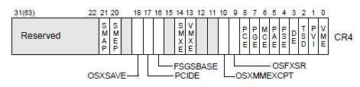
How does it work?
Feature enabled by the OS
Detects ring-0 code running in user space
User space = Memory space used by applications programs (stack, heap, code, etc).
Ring-0 code is used by kernel OSs
Ring-3 code is used by applications

Slide 10
SMEP CPU support
Desktop processors
Intel Core: Lastest models of i3, i5, i7
Intel Pentium: G20X0(T) and G21X0(T)
Intel Celeron: G1610(T), G1620(T) and G1630
Server processors
Intel Xeon: Lastest models of E3, E5, E7
Intel Pentium: 1403v3 and 1405v2

Slide 11
SMEP Protection
We control EIP/RIP = 0x41414141 in Ring-0
So, we can jump where we want to …
4GB
KERNEL
?
2GB
USER
0

Slide 12
Windows SMEP bypass techniques – Part 1

Slide 13
Option 0: Jumping to user space
Jump to user space (to my “code”)
If (EIP/RIP == USER memory pages)
Page Fault → BSoD
Error: ATTEMPTED_EXECUTE_OF_NOEXECUTE_MEMORY
4GB
KERNEL
2GB
USER
0

Slide 14
Option 1 - x86: Jumping to kernel heap
Jump to kernel data (Heap):
E.g: “Windows 8.1” 32 bits
Data allocated in POOL TYPE = 0x21
0x21 = NonPagedPoolSession + NonPagedPool = executable!
SMEP bypass ☺ ☺ ☺
http://blog.ptsecurity.com/2012/09/intel-smep-overview-and-partial-bypass.html

Slide 15
Option 1 - x64: Jumping to kernel heap
Jump to kernel data (Heap):
E.g: “Windows 8.1” 64 bits
Data allocated in POOL TYPE = 0x21
0x21 = NonPagedPoolSession + NonPagedPool = NO executable?
No longer an option ☹

Slide 16
Option 2: ROPing in kernel space
Jump to kernel code (win32k.sys):
Get modules addresses with NtQuerySystemInformation() (only in Medium Integrity since Windows 8.1)
If running in Low Integrity we need memory leaks
You need to write a ROP chain to bypass SMEP

Slide 17
Option 2: ROPing to Turn off SMEP
Turn off the bit 20th of the CR4 register
E.g “mov rax,0xFFFEFFFFF”/ “mov cr4,rax”/”ret“
Jump to USER SPACE ☺
Problem: Restore the CR4 register (PatchGuard!)
The most well-known technique !
http://blog.ptsecurity.com/2012/09/bypassing-intel-smep-on-windows-8-x64.html

Slide 18
Windows Paging Mechanism

Slide 19
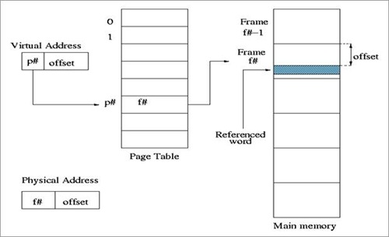
Paging 101
Paging is a functionality provided by the MMU and used by the processor to implement virtual memory.
A virtual address is the one used in processor instructions; this must be translated into a physical address to actually refer a memory location.

Slide 20
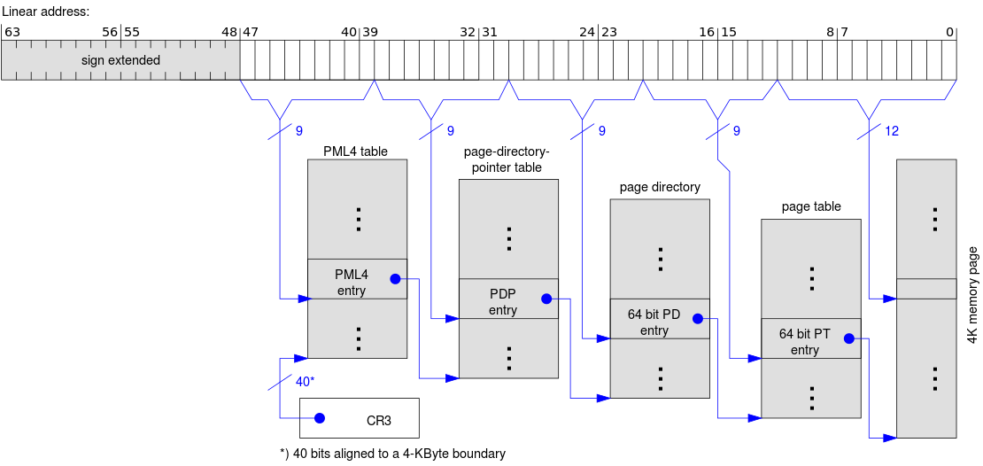
Windows Paging x64

Slide 21
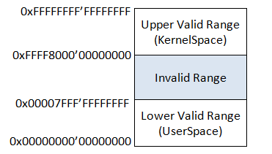
Canonical Addresses
With 64bits we can address 2⁶⁴ bytes of memory (16 Exabytes). Current x64 processors however, limit the number of bits to 48, but instead of simply disallowing bits 48-63, they set them to be equal to bit 47.
Attempting to use a non-canonical address causes a Page Fault exception.

Slide 22
PxE Structure
Interesting fields to know for our purposes:
R/W: readonly/readwrite
U/S: if set, the range mapped by the entry is accessible at CPL3. Otherwise it is only accessible at CPL0.
XD: if set, instruction fetching is not allowed for the region mapped by the entry.
63 | 62:52 | 51:12 | 11 | 10 | 9 | 8 | 7 | 6 | 5 | 4 | 3 | 2 | 1 | 0
XD | I | PFN | I | I | I | G | PAT | D | A | PCD | PWT | U/S | R/W | P

Slide 23
Self-ref Entry
Entry 0x1ED = 1 1110 1101
Since bit 47 is 1, all the bits 48-64 must be 1 to be a valid canonical address
Range: 0xFFFFF680’00000000 – 0xFFFFF6FF’FFFFFFFF
1111 | 1111 | 1111 | 1111 | 1111 | 0101 | 1XXX | XXXX
F | F | F | F | F | 6 | 8-F | 0-F

Slide 24
Self-ref Entry
F | F | F | F | F | 6 | 8 | 0 | 0 | 0 | 0 | 0 | 0 | 0 | 0 | 0
1111 | 1111 | 1111 | 1111 | 1111 | 0101 | 1000 | 0000 | 0000 | 0000 | 0000 | 0000 | 0000 | 0000 | 0000 | 0000
PML4
PDPT
PD
PT
0
0
0
1ED
CR3

Slide 25
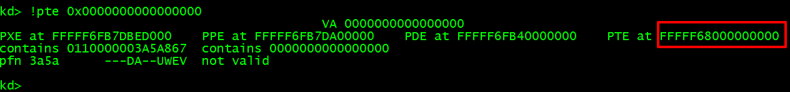
Quick Formula
_int64 get_pxe_address(_int64 address)
{
_int64 result = address>>9;
result = result | 0xFFFFF68000000000;
result = result & 0xFFFFF6FFFFFFFFF8;
return result;
}

Slide 26
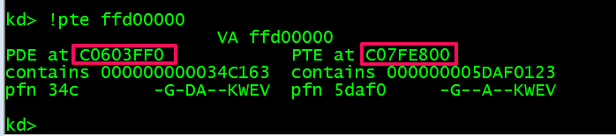
Quick Formula
int get_pxe_32(int address) {
int result = address>>9;
result = result | 0xC0000000;
result = result & 0xC07FFFF8;
return result;
}

Slide 27
Windows SMEP bypass techniques – Part 2

Slide 28
Option 3: Unprotecting HAL.DLL heap
Using multiple arbitrary writes (ROPing or not)
Write shellcode in this area:
Address - 32 bits = 0xffd00000 (no ASLR)
Address - 64 bits = 0xffffffff’ffd00000 (no ASLR)
Turn off the NX bit HAL’s heap
Overwrite a HAL’s heap function pointer
Jump to HAL’s heap ☺
https://drive.google.com/file/d/0B3P18M-shbwrNWZTa181ZWRCclk/edit?pli=1

Slide 29
U = S

Slide 30
Option 4: Deceiving SMEP
If SMEP detects ring-0 code running in USER SPACE (USER PAGES)
If PTE tables are in fixed addresses
What about changing our USER PAGE to SUPERVISOR PAGE? … ☺

Slide 31
Flipping U/S
Option 4: “First time somebody mentioned this”
Conference: NSA - Trusted Computing (2011)
Speaker: Stephen Fischer
https://www.ncsi.com/nsatc11/presentations/wednesday/emerging_technologies/fischer.pdf
Slide: 9

Slide 32
Flipping U/S
Option 4: “… and then …”
Blog: Windows 8 Kernel Memory Protections Bypass
Author: MWR LABS - Jérémy Fetiveau
https://labs.mwrinfosecurity.com/blog/2014/08/15/windows-8-kernel-memory-protections-bypass
Section: “Modifying Paging Structures“

Slide 33
Flipping U/S
Option 4: “… and finally”
Conference: Infiltrate 2015
Speaker: Alex Ionescu
http://www.alex-ionescu.com/infiltrate2015.pdf
Slides: 69 and 71 …

Slide 34
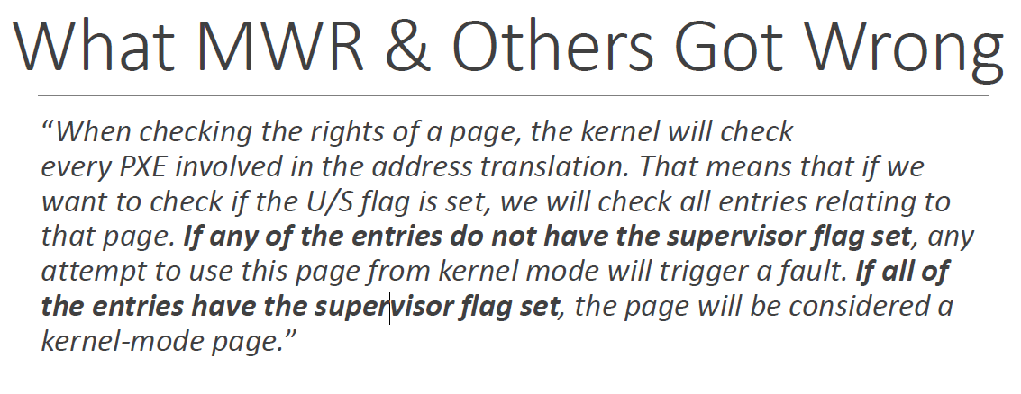
A. Ionescu at Infiltrate 2015
We also found the same behavior on our own
so, it’s FALSE !

Slide 35
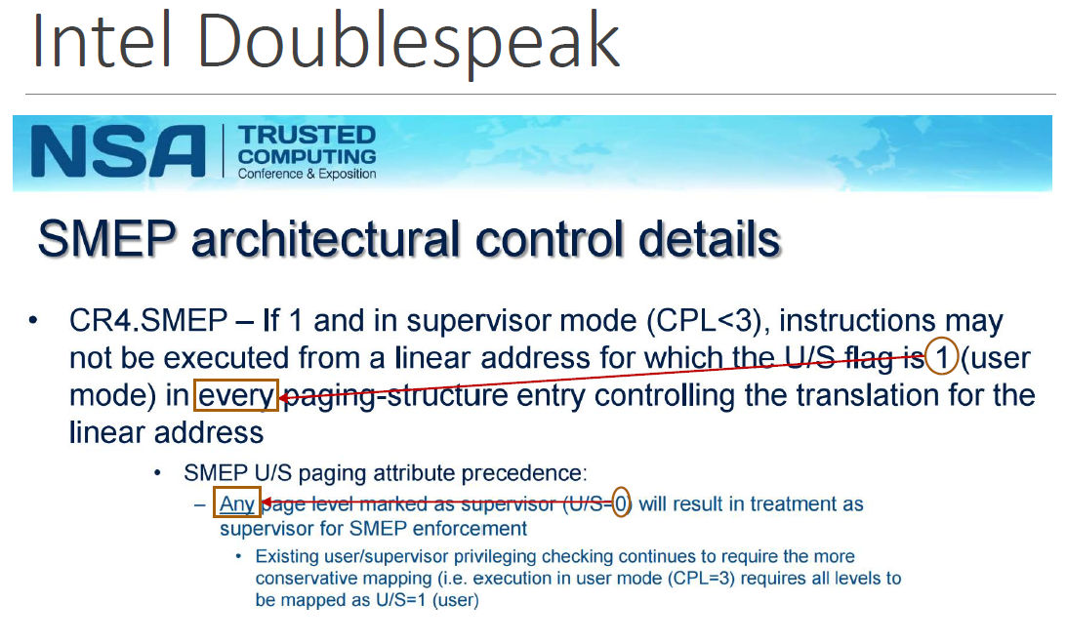
A. Ionescu at Infiltrate 2015

Slide 36
Flipping U/S
Breaking Rules
PDPT 1
PD 1
PT 1
PAGE 1
S
S
S →U
PML4
U
S
U
U
U →S
PDPT 2
PD 2
PT 2
PAGE 2

Slide 37
Mapping a Kernel Page in User Space
4GB
KERNEL
!!!
2GB
USER
0
The processor will not generate an exception!

Slide 38
Demo time

Slide 39
CVE-2015-5736
Exploit:
“Fortinet Antivirus Multiple Vulnerabilities” (CVE-2015-5736)
Arbitrary function callback feature?
Local Privilege escalation
http://www.coresecurity.com/advisories/forticlient-antivirus-multiple-vulnerabilities

Slide 40
Exploit for CVE-2015-5736
Target:
“Windows 10” 64 bits + “Forticlient <= 5.2.3” installed
Scenario:
We can’t jump directly to USER SPACE (SMEP!)
No registers poiting to our DATA!
The only way, Stack Pivoting to USER SPACE
Objective:
Write a ROP chain to avoid SMEP!
Run our RING-0 code in USER SPACE

Slide 41
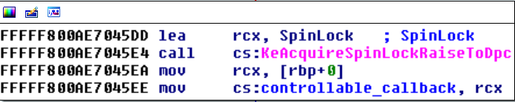
Exploit for CVE-2015-5736
Vulnerable Driver: FortiShield.sys
A filesystem filter driver that hooks several operations -> IRP_MJ_SET_INFORMATION
IOCTL: 220028h
RCX Controllable

Slide 42
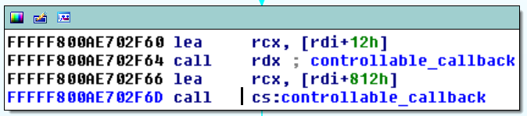
Exploit for CVE-2015-5736
Arbitrary Callback: Invoked via MoveFileEx()
We control this call

Slide 43
Exploit for CVE-2015-5736
Gadget finding:
Tool: Agafi - https://github.com/CoreSecurity/Agafi
Trick: Many 64 bit instr. are equal to 32 bit instr.
Manual search: We found the rest!
Result: ALL gadgets located in HAL.DLL … ☺

Slide 44
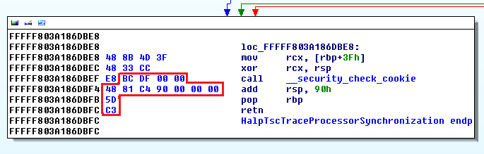
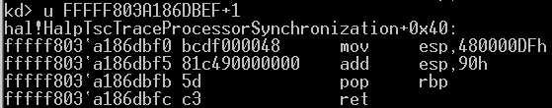
ROP in KernelSpace
Special gadget: Stack Pivoting to user space
thanks AMD !

Slide 45
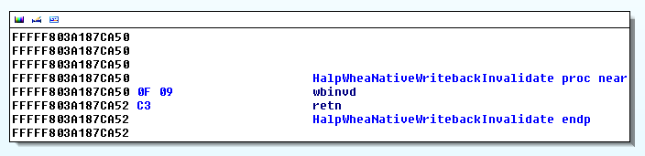
ROP in KernelSpace
Special gadget: Disabling the CPU TLB cache
It refreshes the TLB cache !

Slide 46
ROP in KernelSpace
ROPing to “hal.dll” - “Windows 10” 64 bits
STACK
in
KERNEL SPACE
HAL + 0x6bf0
Stack Pivoting to USER SPACE
HAL + 0x668e
“pop rdx”
0x63
DIRTY + ACCESSED + R/W + PRESENT
HAL + 0x987e
“pop rax”
STACK
in
USER SPACE
PTE (MY_ADDR) - 3
HAL + 0xe2cf
“mov [rax], edx”
HAL + 0x15a50
“ret” to Invalidate cache !!!
MY_ADDR
“ret” to new kernel address ☺

Slide 47
Demo time now

Slide 48
Conclusions
The PML entry (0x1ed) should be RANDOMIZED
256 entries are available for the OS kernel
Only ~20 entries are used by Windows
Paging tables (PTs) shouldn’t be in PREDICTABLE VAs
It can be abused by LOCAL and REMOTE kernel exploits
Virtualization ?
Enabled by VSM in Windows 10
Multiples EPTs (Extended Pages Tables - SLAT) could be a solution

Slide 49
Conclusions
This bypass technique is useful when EIP/RIP is controllable (directly or via ARB. WRITE)
Windows SMEP kernel exploit mitigation
Easily bypassable
Only useful when we are in Low Integrity Level

Slide 50
Questions?

Slide 51
Thank You
Enrique Nissim
@kiqueNissim
enissim@coresecurity.com
Nicolas Economou
@NicoEconomou
neconomou@coresecurity.com

